Slide 1
Relational Database Model
Basic Concepts
Mathematical Foundation

Slide 2
Performance Requirements
Abstraction
Data abstraction
Execution abstraction
Reliability
High availability: recovery time is short
Trusted/Quality data
Efficiency/Performance
High throughput
(Committed transactions per unit time)
Short or bounded response time
Energy Efficiency

Slide 3

Database Management System (DBMS)
Web
Forms
Embedded
SQL
Interactive
SQL
Applications
SQL Commands
DBMS
Query
Evaluation Engine
Concurrency
Control
Files and Access Methods
Recovery
Manager
Buffer Manager
Disk Space Manager
Database
Data
Indexes
Catalog
Notes:
Trace a transaction…

Slide 4

Data Modeling
Problem
?
MiniWorld
Reality of Interest
DBS
Modeling

Slide 5
Relationships

Slide 6
Relational Model - History
Before: records, pointers, sets, etc.
Hierarchical Data Model (IBM IMS,1966-68)
Network Data Model (CODASYL DBTG, 1969)
Introduced by E.F. Codd in 1970
Revolutionary!
First systems: 1977-8
System R; Ingres
Turing award in 1981
Notes:
CODASYL (Conference on Data Systems Languages) or DBTG (Data Base Task Group)

Slide 7
Relational Model
SID | Name | Major | GPA
546007 | Susan | CS | 3.80
546100 | Bob | CoE | 3.65
546500 | Bill | CS | 3.70
CID | Name
CS1555 | DB
CS1530 | SW
CS1550 | OS
SID | CID | Grade
546007 | CS1550 | A
546007 | CS1530 | B+
546100 | CS1550 | B
Students
Courses
Enrollment
It is the most popular implementation model
Simplest, most uniform data structures, and is the most formal of all data model
Both entity types and relationship types are represented by relations, i.e., tables

Slide 8
The Mathematical Concept of Relation
Let D₁, D₂,…, D_{n} be domains (not necessarily distinct), the Cartesian product of these n sets
D₁ x D₂ x … x D_{n}
is the set of all possible ordered n-tuples
(v₁, v₂,…, v_{n} ) such that v₁∈D₁, v₂∈D₂, …, v_{n}∈D_{n}
E.g., let D₁= {Nick, Susan} and D₂= {BS, MS, PhD}
D₁ x D₂ = {(Nick, BS), (Nick, MS), (Nick, PhD), (Susan, BS), (Susan, MS), (Susan, PhD)}
Α relation is any subset of the Cartesian product
R₁= {(Nick, BS),(Nick, MS), (Susan, BS), (Susan, PhD)}
R₂= {}

Slide 9
Two Notations
Relation schema R is denoted by
R = {A₁:D₁, A₂:D₂,..., A_{n}:D_{n}} or R = {A₁, A₂,…, A_{n}}
or R (A₁, A₂,…, A_{n})
Set-of-attributes
A tuple t of r(R) is denoted by
t ={A₁:v₁, A₂:v₂,..., A_{n}:v_{n} }, v_{i}∈D_{i}, 1≤ i ≤ n or
t = <(A₁:v₁), (A₂:v₂),..., (A_{n}:v_{n})>, v_{i}∈D_{i}, 1≤ i ≤ n
List of attributes
A tuple t of r(R) is denoted by
t =(v₁, v₂,..., v_{n}) , v_{i}∈D_{i}, 1≤ i ≤ n

Slide 10
SQL Insert
STUDENT(SID, Name, Major, GPA)
Implicit (list):
INSERT INTO STUDENT
VALUES (165, `Susan Jones`, ‘CS’, 0.00);
Explicit (set):
INSERT INTO STUDENT (SID, Name)
VALUES (165, `Susan Jones`);
INSERT INTO STUDENT (Name, SID)
VALUES ( `Susan Jones`, 165);
Values-clause may be a list of tuples in some systems

Slide 11
Properties of Relations
A relation is finite
There are no duplicate tuples in a relation
Recall a relation is a set of tuples
Order of tuples in a relation is not important
Many logical orders can be specified on a relation
A value may appear multiple times in a column
Order of attribute values in a tuple is
important in a list-of-attributes definition
not important in a set-of-attributes definition

Slide 12
Relation Schema
STUDENT
SID | LName | Name | Class | Major
Schema
123 | Smith | John | 3 | CS
395 | Aiken | Mary | 4 | CS
What is the meaning?
A relation schema R specifies
The name of the relation
the attribute names A_{i} of R
the domain D_{i} (data type + format) for each attribute A_{i}
data type is a set of atomic data values:
no attribute is a set-valued (1st Normal Form, 1-NF)
no attribute is composite
format specifies the representation of a data value

Slide 13
Example Table Schema
Schema of STUDENT(SID, Name, Major, GPA)
CREATE TABLE STUDENT
( SID INTEGER,
Name CHAR(20),
Major CHAR(4),
GPA DEC(3,2)
);

Slide 14

Creating a Schema
Corresponding database is at an empty state!
Initial state when the database is populated (loaded)
Domain (type) of each field is specified and enforced by the DBMS whenever tuples are added or modified

Slide 15
Example: Domain Constraints
SID | Name | Login | Age | GPA
546007 | Jones | jones@cs | 18 | 3.4
546100 | Smith | smith@ee | 18 | 3.2
546500 | Smith | smith@math | 19 | 3.8
Example of IC Violation:
UPDATE Students
SET Age = `Eighteen`
WHERE Name = Jones;
✗ ✗ ✗

Slide 16
Useful Terms
Cardinality of a relation r(R): # of tuples in r(R) (denoted by |r(R)|)
Arity or degree of r(R): # of attributes in R (denoted by |R|)
SID | Degree | Major | Year
|R| = 4
|r(R)| = 3
123 | BS | Math | 1992
064 | BA | History | 1991
445 | PhD | CS | 1999
|R| > 0 and |r(R)| ≥ 0
Cardinality is property of a relation
Arity is property of relation schema or a relation

Slide 17

Relational Database Schema
A database schema is a set of relation schemas and a set of integrity constraints
Integrity Constraints
Structural Integrity Constraints
key constraints: uniqueness of keys
entity integrity constraint: no primary key value can be NULL
referential integrity constraint
Semantic Integrity Constraints
E.g., ??
Notes:
NULL Value…explain!!!

Slide 18
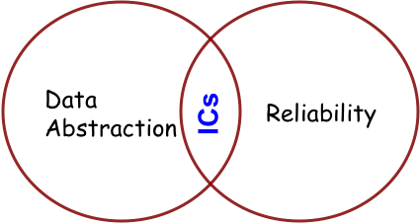
Integrity Constraints (ICs)
IC: condition that must be true for any instance of the database (e.g., domain constraints)
A legal instance of a relation is one that satisfies all specified ICs
ICs are specified when schema is defined
ICs are enforced when tables are modified

Slide 19

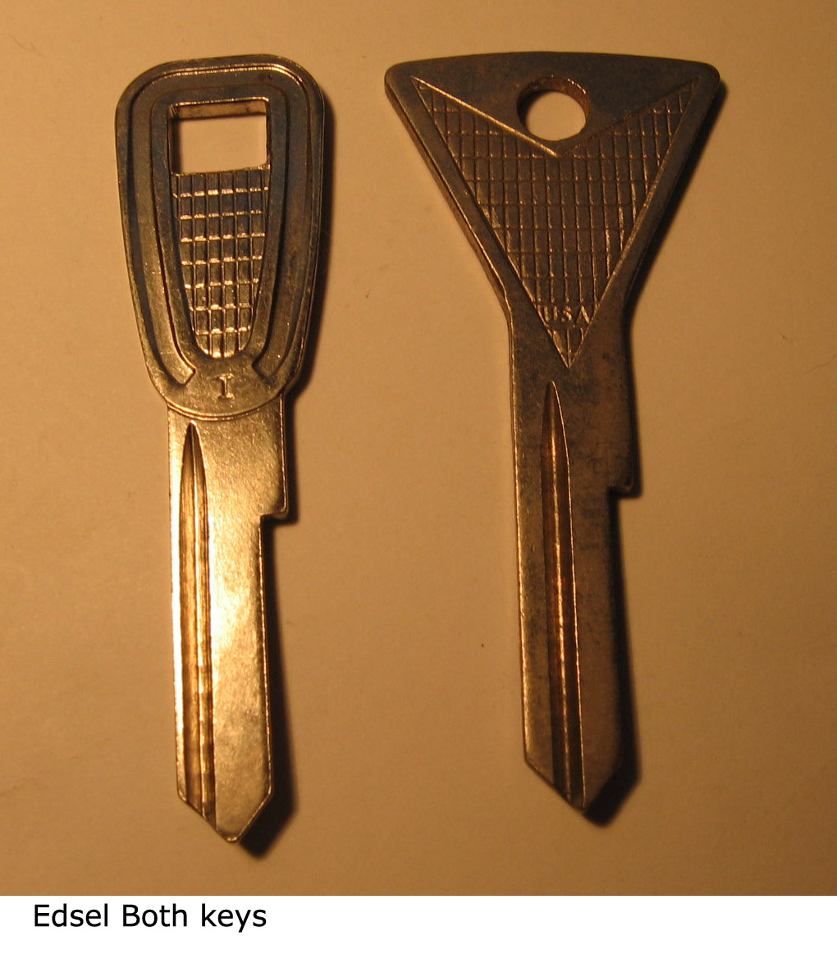
Primary Key Constraint
A set of fields is a key for a relation if :
No two distinct tuples can have same values in all key fields
If there is more than one key for a relation:
Each is called a candidate key
One candidate key is designated as the primary key
Other candidate key(s) are designated as alternative or unique key(s)

Slide 20
Example of Keys
SID | Name | Login | Age | GPA
546007 | Jones | jones@cs | 18 | 3.4
546100 | Smith | smith@ee | 18 | 3.2
546500 | Smith | smith@math | 19 | 3.8
Candidate Keys: SID, and Login
Primary Key: SID
Unique Key: Login

Slide 21
Example Table Schema in SQL
Schema of STUDENT(SID, Login, Name, Major, GPA)
CREATE TABLE STUDENT
( SID INTEGER NOT NULL,
Login CHAR(15),
Name CHAR(20),
Major CHAR(4),
GPA DEC(3,2),
CONSTRAINT STUDENT_PK
PRIMARY KEY (SID),
CONSTRAINT STUDENT_UN
UNIQUE (Login) -- UNIQUE can take NULL values
);
Notes:
UNIQUE can take NULL values without violating entity constraint. Oracle can accept multiple NULLs.

Slide 22
Example Table Schema in SQL (2)
Schema of STUDENT(SID, Login, Name, SSN, GPA)
CREATE TABLE STUDENT
( SID INTEGER NOT NULL,
Login CHAR(15),
Name CHAR(20),
SSN CHAR(9),
GPA DEC(3,2),
CONSTRAINT STUDENT_PK PRIMARY KEY (SID),
CONSTRAINT STUDENT_UN_SSN
UNIQUE (SSN),
CONSTRAINT STUDENT_UN_Login
UNIQUE (Login)
);
Notes:
UNIQUE can take NULL values without violating entity constraint. Oracle can accept multiple NULLs.

Slide 23
Example Table Schema in SQL (3)
Schema of STUDENT(SID, SSN, Name, Login, GPA)
CREATE TABLE STUDENT
( SID INTEGER
CONSTRAINT STUDENT_PK_ΝOT_NULL NOT NULL
CONSTRAINT STUDENT_PK PRIMARY KEY,
SSN CHAR(9) CONSTRAINT STUDENT_UN_SSN UNIQUE,
Name CHAR(20),
Login CHAR(15),
GPA DEC(3,2),
CONSTRAINT STUDENT_UN_Login
UNIQUE (Login)
);
Notes:
UNIQUE can take NULL values without violating entity constraint. Oracle can accept multiple NULLs.

Slide 24
Identifying the Key
What is the key in relation GRADUATE=(SID, Degree, Major, Year) ?
SID | Degree | Major | Year
123 | BS | CS | 1992
123 | MS | CS | 1993
064 | BA | History | 1991
445 | PhD | CS | 1999
123 | BS | Math | 1992
123 | MS | Math | 1992
Notes:
SID
(SID, Degree) or (SID, Year)
(SID, Degree, Major) or (SID, Major, Year)
(SID, Degree, Major, Year)

Slide 25

Foreign Keys
Foreign key (FK) in relation R₂ is a set of attributes of R₂ that forms a primary key (PK) of another relation R₁.
Attributes in FK and PK have the same domain
STUDENT
COURSE
SID | Degree | Major | Year
PK
CID | Name
PK
FK
FK
Enrolled
SID . | CID | Grade
PK

Slide 26
Foreign Key & Primary Key
SID | Name | Age
546007 | Susan | 18
546100 | Bob | 19
546500 | Bill | 20
SID | CID | Grade
546007 | CS1555 | A
546007 | CS1550 | B+
546500 | CS1555 | B
CID | Name
CS1555 | DB
CS1530 | SW
CS1550 | OS
Foreign Key
Enrolled
Courses
Primary Key
Students
Foreign key: Set of fields in one relation that is used to “refer” to a tuple in another relation
Must correspond to primary key of the referred relation
E.g. SID is a foreign key referring to Students

Slide 27
Foreign Key Constraints
If foreign key constraints are enforced, referential integrity is achieved
E.g.: Only students can enroll in a class
Only students listed in the “Students” relation should be allowed to enroll for courses
Like a “logical pointer”
There shouldn’t be dangling references
Either valid PK or NULL

Slide 28
Any Attribute can be a Foreign Key
Faculty
Courses
FID | Name | Area
007 | Panos | DB
100 | Daniel | OS
500 | Adriana | AI
CID | Name | Instructor
CS1555 | DB | 007
CS1530 | SW | NULL
CS1550 | OS | 100
Primary Key
Primary Key
Foreign Key
Foreign key: Set of fields in one relation that is used to “refer” to a tuple in another relation
Must correspond to primary key of the referred relation
If not part of a key, it could be NULL

Slide 29
Foreign Keys in SQL
SID | Name | Major | GPA
CID | Name
SID | CID | Grade
Students
Courses
Enrolled
CREATE TABLE Enrolled (
SID CHAR(20), CID CHAR(20), Grade CHAR(2),
CONSTRAINT Enrolled_PK PRIMARY KEY (SID, CID) ,
CONSTRAINT Enrolled_FK_sid
FOREIGN KEY (SID) REFERENCES Students (SID) ,
CONSTRAINT Enrolled_FK_cid
FOREIGN KEY (CID) REFERENCES Courses
);

Slide 30
Referential Integrity Constraints
SID | Name | Age
546007 | Susan | 18
546100 | Bob | 19
546500 | Bill | 20
SID | CID | Grade
546007 | CS1555 | A
546007 | CS1530 | B+
546500 | CS1555 | B
CID | CName
CS1555 | DB
CS1530 | SW
CS1550 | OS
Enrolled
Courses
Students
Any IC Violation? [Poll]
DELETE
FROM Enrolled
WHERE SID = 546500;
No Violations! ✓

Slide 31
Referential Integrity Constraints
SID | Name | Age
546007 | Susan | 18
546100 | Bob | 19
546500 | Bill | 20
SID | CID | Grade
546007 | CS 1555 | A
546007 | CS1530 | B+
546500 | CS 1555 | B
CID | CName
CS 1555 | DB
CS1530 | SW
CS 1550 | OS
Enrolled
Courses
Students
Any IC Violation? [Poll]
DELETE
FROM Students
WHERE SID = 546500;
Violation! ✗

Slide 32
Referential Integrity Enforcement
What are the alternatives when a “Students” tuple is deleted?
Delete all Enrolled tuples that refer to it
Disallow deletion of a Students tuple that is referred to
Set SID in Enrolled tuples that refer to it to some “default” SID (e.g., 000000)
If SID was not part of the primary key, Set SID to a special value “NULL”, denoting “unknown” or “inapplicable”

Slide 33
Referential Integrity in SQL
SQL/92 and SQL/99 support all 4 options on delete and update:
NO ACTION (default)
delete/update is rejected
CASCADE
also delete all tuples that refer to deleted tuple
SET NULL / SET DEFAULT
sets foreign key value of referencing tuple

Slide 34
RI Trigger Actions in SQL
SID | Name | Major | GPA
CID | Name
SID | CID | Grade
Students
Courses
Enrolled
CREATE TABLE Enrolled (
SID CHAR(20), CID CHAR(20), Grade CHAR(2),
CONSTRAINT Enrolled_PK PRIMARY KEY (SID, CID) ,
CONSTRAINT Enrolled_FK_sid
FOREIGN KEY (SID) REFERENCES Students (SID) ,
CONSTRAINT Enrolled_FK_cid
FOREIGN KEY (CID) REFERENCES Courses
ON UPDATE CASCADE ON DELETE NO ACTION
);

Slide 35

Enforcing Integrity Constraints [Poll]
What would be the outcome?
Insert (585811, ’Jie’, 19, 3.95) into Students
Insert (585811, NULL, NULL) into Enrollment
Insert (546100, ’CS1555’, NULL) into Enrollment
Insert (546100, ’Mary’, 18, 3.65) into Students
Delete (’CS1530’) from Courses
✓
✗
✓
✗
✗
SID | Name | Age | GPA
546007 | Susan | 18 | 3.8
546100 | Bob | 19 | 3.65
546500 | Bill | 20 | 3.7
CID | Name
CS1555 | DB
CS1530 | SW
CS1550 | OS
SID | CID | Grade
546007 | CS1550 | A
546007 | CS1530 | B+
546100 | CS1550 | B
Students
Courses
Enrollment
Notes:
Identify PK & FK
Apply operations

